Slide 1
Chestnut Phenotypes

Slide 2
Collecting samples in nature
What is the goal?
How do you identify those specimens you want from everything else that looks similar but is something else?
What part of the specimen is important to later studies?
How do you preserve the part(s) you care about?
How do you make sure your record-keeping is good? What things should go in the record?

Slide 3
Known differences in the two species
The overall height and shape of the two trees is quite different
Density of simple vein hairs on the lower (abaxial) surfaces
The abaxial interveinal leaf surface of the American chestnut is glabrous (smooth, without hairs)
The abaxial interveinal leaf surface is pubescent in the Chinese chestnut (very hairy)
Density of simple twig hairs in the leaf midribs and secondary veins
The petiole, midrib and secondary vein of the Chinese chestnut Sun leaves are covered in dense simple hairs as are the twigs, while they are not visible on the twigs and sparse on the other parts of the American chestnut
Stipule size (little outgrowths on each side of a leaf where it joins the petiole)
Stipules are wide at the base (5-10mm) of the Chinese chestnut and taper to a point
The American chestnut stipule is narrow at the base (1mm) and slowly tapers to a point.
Stem color
Growing American leaves have a reddish stem
Growing Chinese leaves have a green or tan stem.

Slide 4
American at Maturity: 75-100 ft high, 15 ft in diameter, have a single main trunk
Chinese at Maturity: 40-60ft with a 40-50ft crown, multiple main trunks, branches droop.

Slide 5
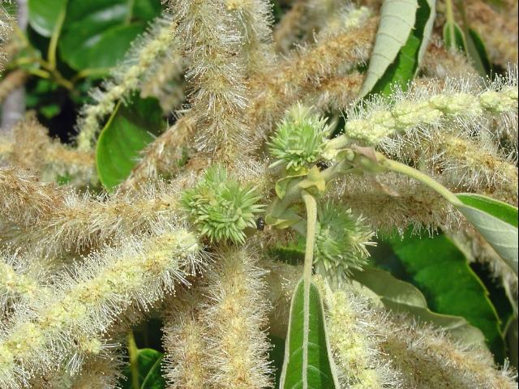
Pollination
Chestnuts are monoecious (mono-ee-shus): both male and female flowers appear at the same time on the same shoots of a tree.
Flowers are on the tips (after leaves expand).
Chestnuts are self sterile – they will not self pollinate. The wind is the major way they are pollinated (not insects).
Seedlings need 5-7 years before they produce nuts.
These are called catkins – the female flowers are at the base and the male flowers extend along the length.

Slide 6
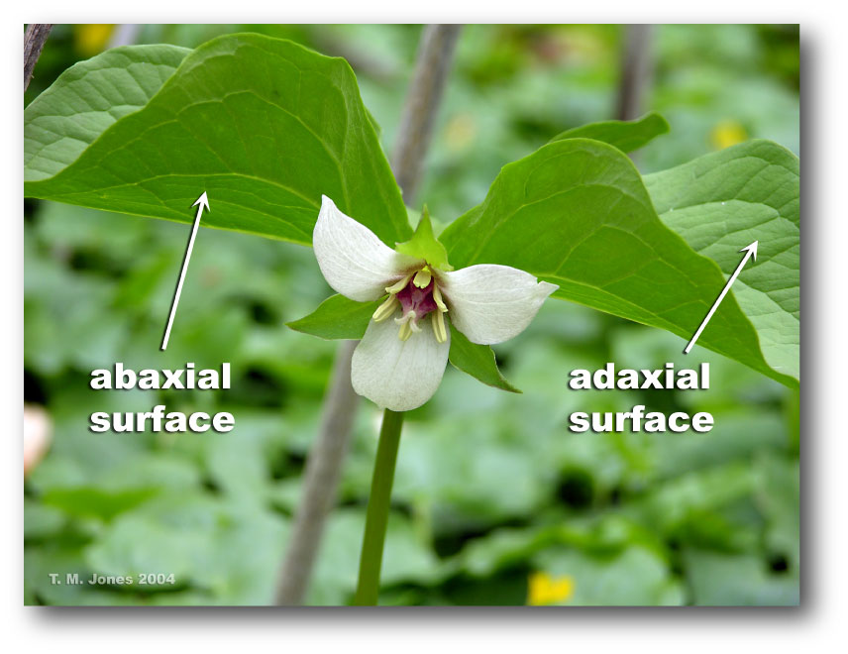
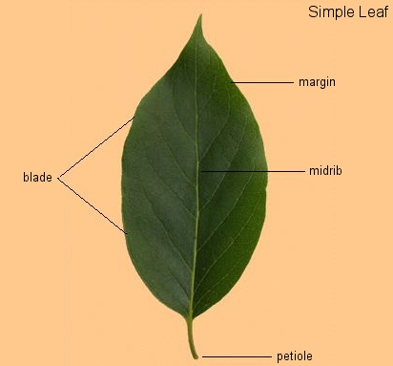
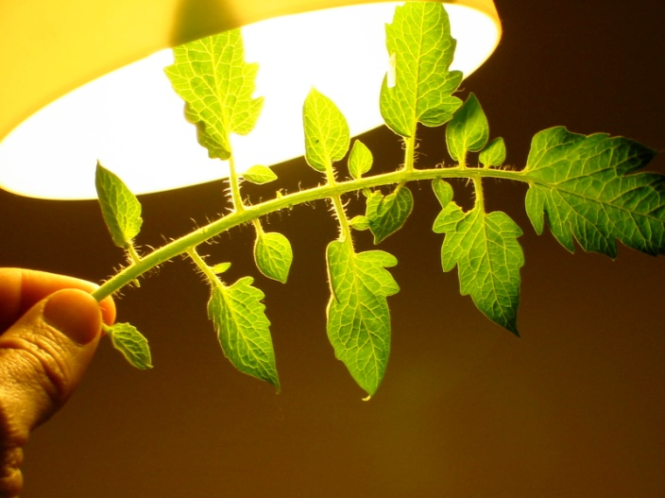
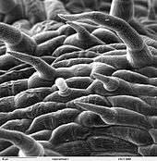
Leaf anatomy and vocabulary
The upper surface of a leaf is called – adaxial
The lower surface of a leaf is called abaxial
The main part of the leaf is the leaf blade or lamina
The little hairs that you can see are called trichomes.

Slide 7
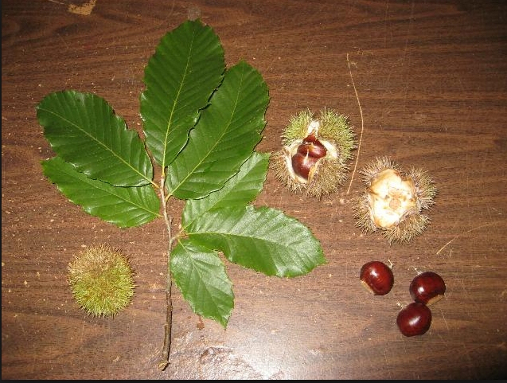
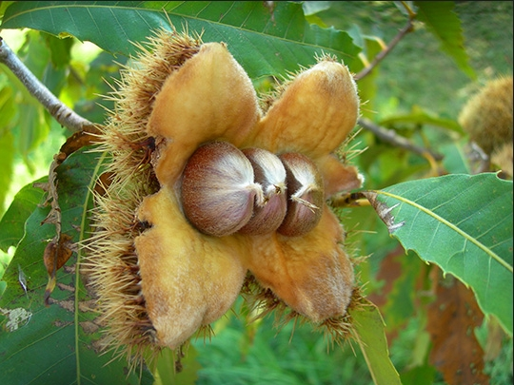
Nuts and Leaves
American leaves have sharp ‘teeth’ and are 5-10 inches long.. Usually there are 3 (to 7) nuts in a bur, they are xxx . The nuts are hairy near the tip.
Chinese chestnut leaves are 4-8 inches long, oblong with serrated edges. There are 1-3 nuts per bur, they are 1-3 inches across, and smooth.

Slide 8
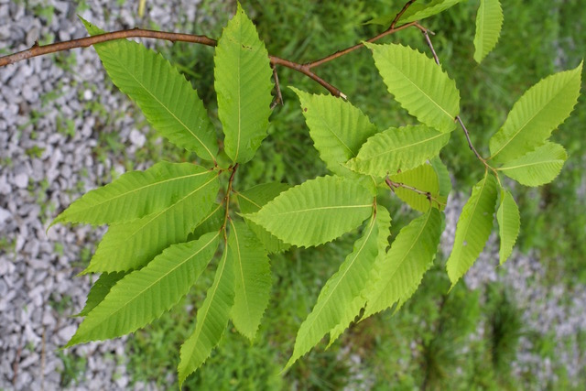
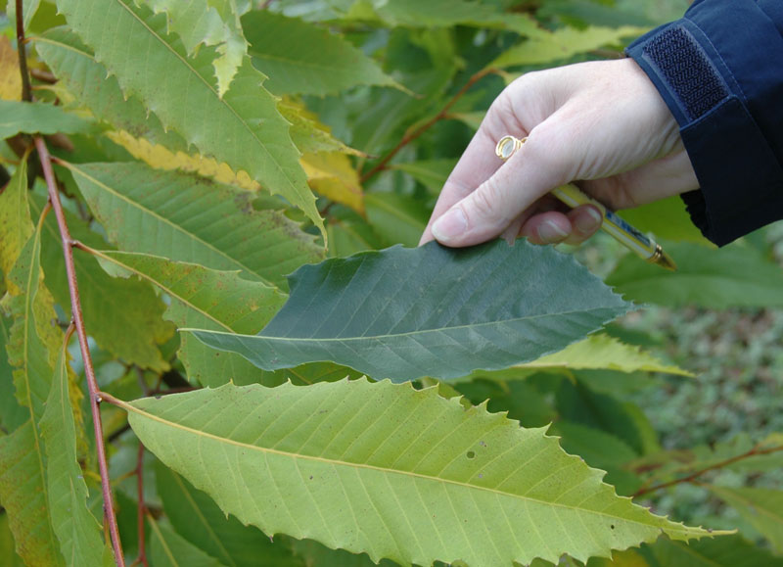
American Chestnut: Twigs and Leaves
The leaves are smooth and thin
There are few hairs on abaxial surface or twig
Petiole is red, twig is brown
There is a very sharp angle where the leaf joins the petiole.

Slide 9
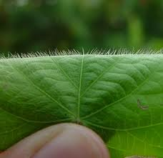
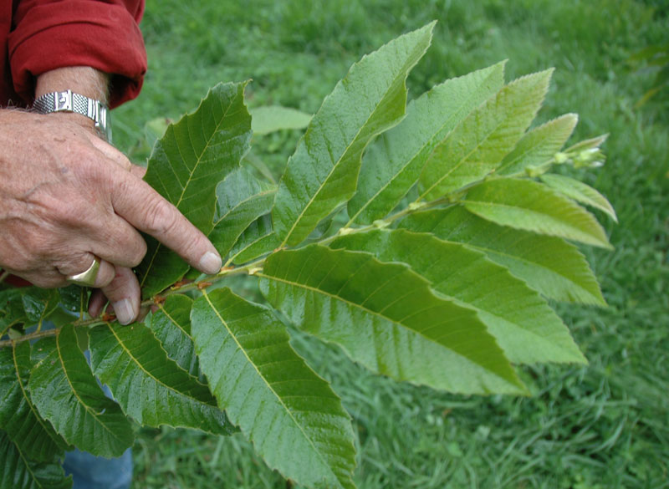
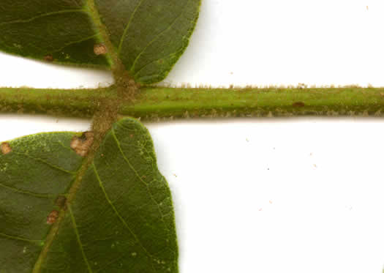
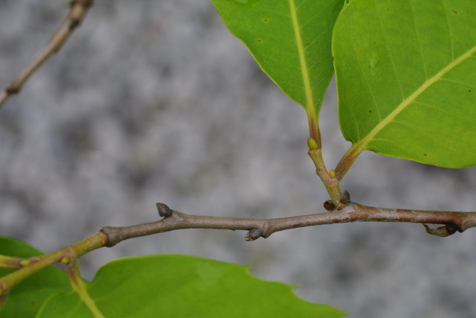
Chinese Chestnut Twigs and Leaves
Chinese: the leaves are thicker, hairy on the lower surface
The twigs are brown and have hairs.
The base where the leaf meets the petiole is wider.
The petiole is green or tan

Slide 10
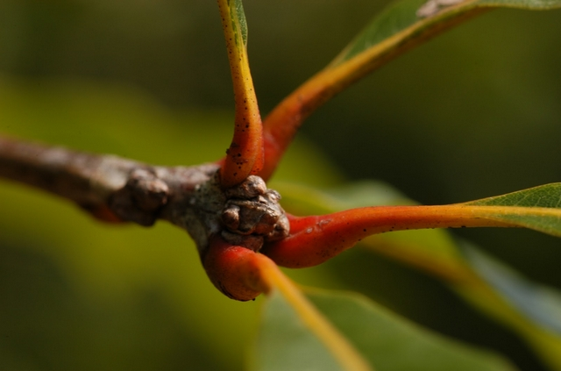
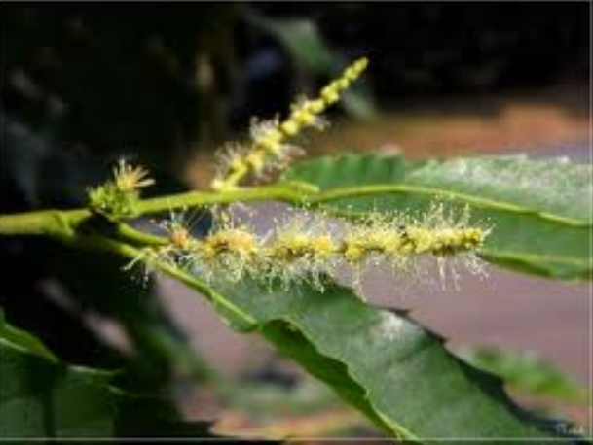
Petiole colors

Slide 11
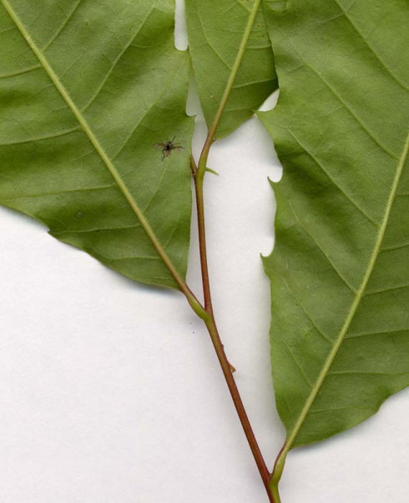
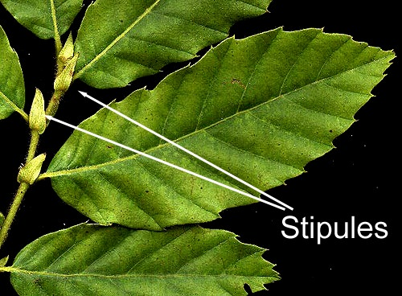
Stipules

Slide 12
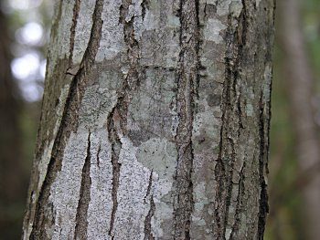
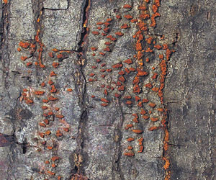
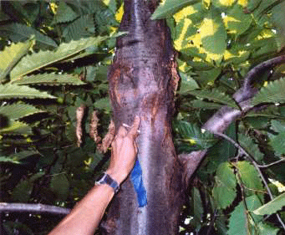
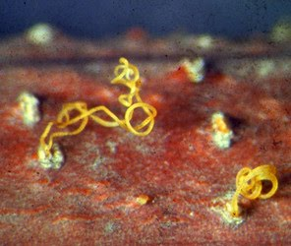
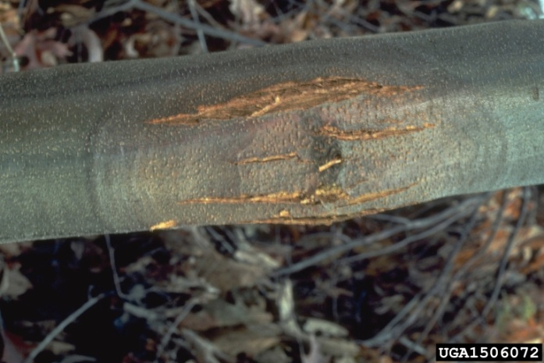
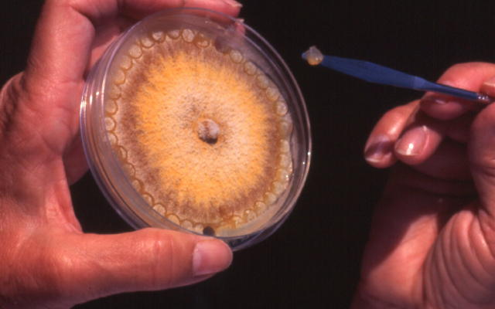
Bark /Blight (Cryphonectria parasitica)
Notes:
Photos: Diane Toomey, American Chestnut Foundation, Carolina Chapter, Wikipedia, Bugwood Network/Forestry Images – Tree of Life Project 2008 Diaporthales.

Slide 13
Good tools
Measuring tape, rulers to mm
Magnifying glass
Camera that can take close-ups.
Notebook or voice recorder
GPS
Sample collection and labeling materials (baggies, tubes, water-proof pens)
Sample preservation materials (ice, dry ice, drying agents, enzyme inhibition materials)

